Slide 1
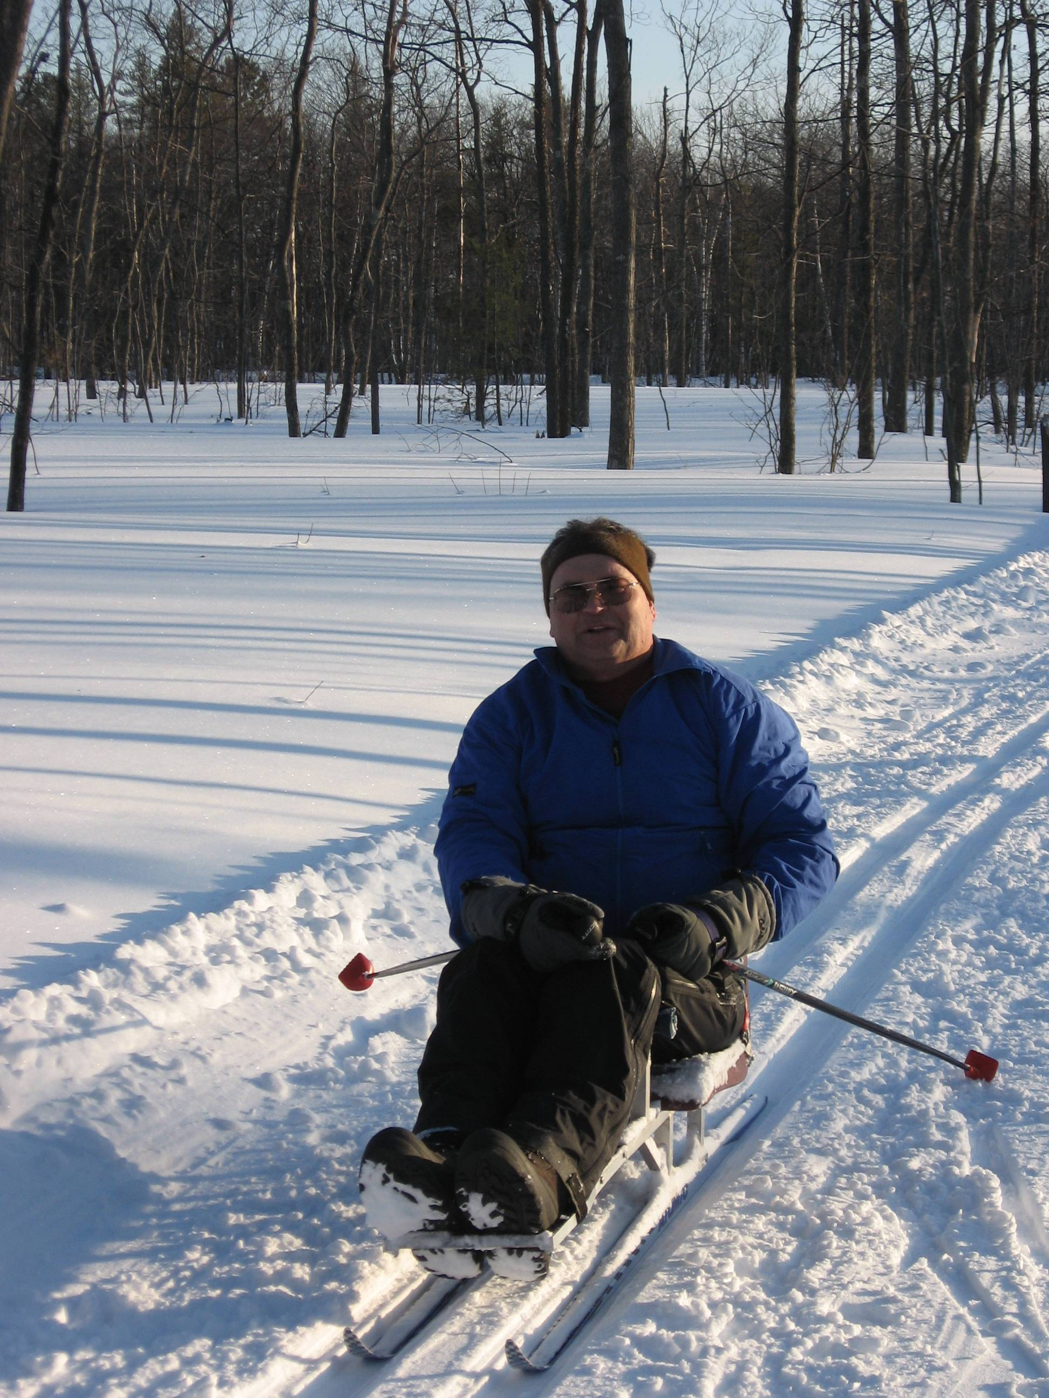
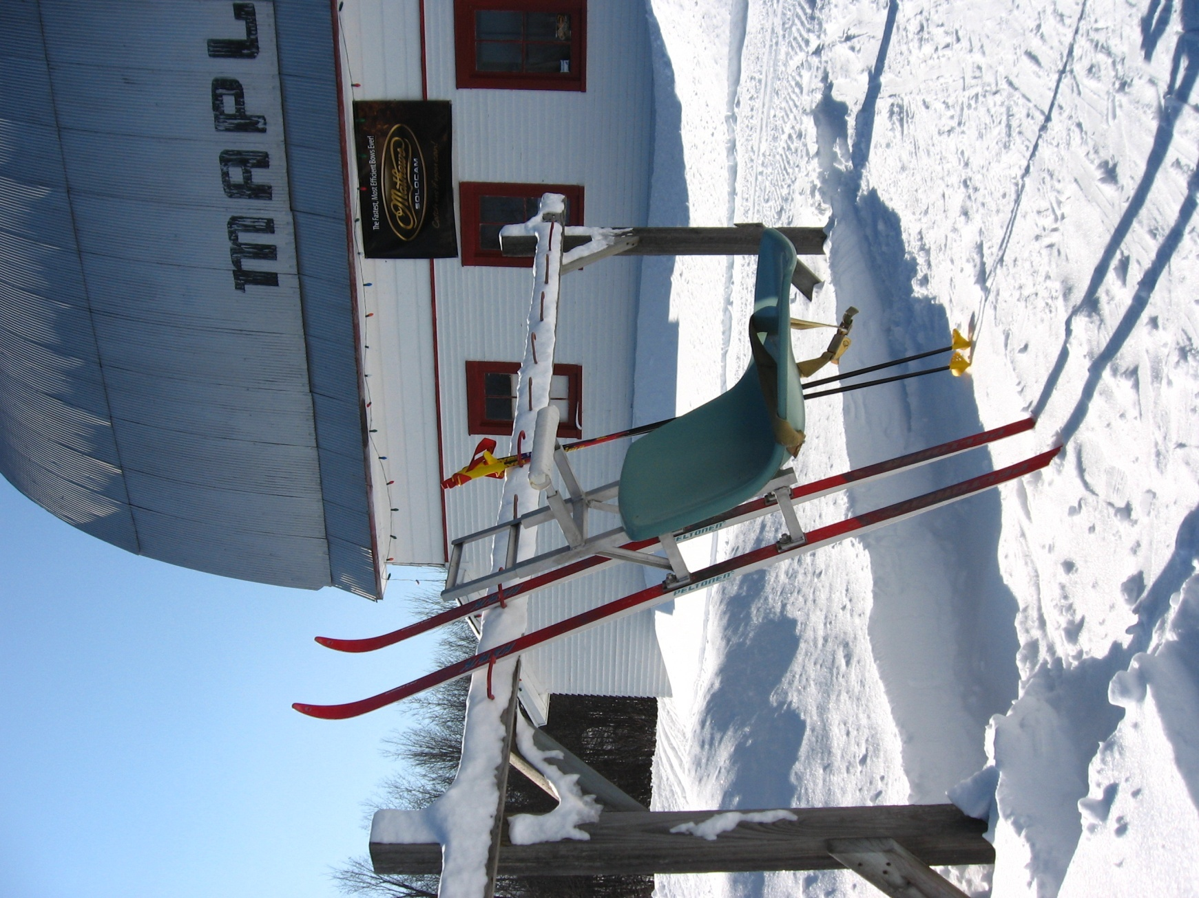
Peak Velocity of Nordic Ski Double Pole Technique: Stand-up vs. Adaptive Sit-Skiing.
Jodi L. Tervo and Randall L. Jensen
Dept. HPER, Northern Michigan University, Marquette, Michigan, U.S.A.
Contact: jotervo@nmu.edu
KEY WORDS: cross country skiing, disabled sports, biomechanics.
METHODS
Four female and two male collegiate athletes participated in stand-up and sit-skiing, and one experienced male sit-skier participated as a subject to reference for the analysis portion of this study. All subjects arrived at an outdoor cross-country ski venue with skis, boots, and poles. Ethical approval (#HS09-242) was received prior to conduction of the study, and the athletes signed an informed consent and PAR-Q questionnaire prior to participating. A Canon Digital Video Camcorder NTSC Optura 20 (Canon Inc., Japan) was placed perpendicular to the ski line approximately 4.5 meters away. A 1/1000 shutter speed was used, with a 60 Hz camera. Each subject had markers placed on their ski binding to allow digitization of movement. They were asked to mimic a race start using the double pole technique. The video captured a recording of at least one complete cycle of double poling. One cycle is defined from pole plant to pole plant. The Peak Motus System version 8.5 (Vicon Motion Systems Inc., Centennial, CO) was used to analyze the data. One poling cycle lasted approximately one second. Using MATLAB each subject’s trial was standardized to one second. This allowed the researchers to calculate the percentage of poling cycle (%PC) for comparisons.
ABSTRACT
Double poling is a technique used in Nordic skiing and is defined when the upper body provides most of the propulsion via bilateral pole pushes. This study compared the point that linear peak velocity of the ski occurs during the poling phase and to see if there is a difference in this point between Olympic style and Paralympic sit-ski double poling. Four female and two male collegiate athletes participated in stand-up and sit-skiing; and one experienced male sit-skier participated as a subject to reference. All subjects arrived at an outdoor cross-country ski venue with skis, boots, and poles. Each subject had markers placed on the ski binding to allow digitization of movement. They were asked to mimic a race start using the double pole technique. The video captured a recording of at least one complete cycle of double poling. The Peak Motus System version 8.5 was used to determine at what percentage of poling cycle (%PC) peak velocity occurred. Paired T-Test indicated that the point at which peak velocity occurs in Nordic sit-skiing (mean ± SD: 0.350 ± 0.066 %PC) and stand-up skiing is (0.231 ± 0.031 %PC) (p = 0.017). A One-sample T-Test comparing the experienced male sit-skier (0.350%PC) to the subjects found no difference (p = 0.995). Results of the study indicate that there is a difference in the point at which peak velocity occurs between Nordic sit-skiing and stand-up skiing.
INTRODUCTION
One of the event styles in cross-country skiing is the classic technique in which the skis move in groomed tracks. Double poling is a technique used under the classic skiing style, and is defined when the upper body provides most of the propulsion via bilateral pole pushes. Double poling during classic cross-country skiing has become more popular in the past twenty years. It has also been shown to have strong correlations with increased race speed (Smith, Fewster, & Braudt, 1996).
Maximal velocity considers an overall velocity of the movements, but does not specify at which point during the poling phase that peak velocity occurs. By breaking a movement down into its components one may be able to critique technique more specifically. This study examined the point at which peak linear velocity of the ski occurred during the double poling cycle phase in Nordic stand-up and sit-down skiing.
RESULTS & DISCUSSION
Paired T-Test indicated that the point at which peak velocity occurs in Nordic sit-skiing (Mean ± SD: 0.350 ± 0.066 %PC) is later than that of stand-up skiing (0.231 ± 0.031 %PC) (p = 0.017). A One-sample T-Test comparing the experienced male sit-skier (0.350%PC) to the collegiate athletes (sit-skiing) found no difference (p = 0.995). Results of the study indicate that there is a difference in the point at which peak velocity occurs between Nordic sit-skiing and stand-up skiing. Furthermore, it may be possible to use experienced stand-up skiers as subjects in sit-skiing research. A larger subject base in the future may allow more extensive conclusions to be made.
CONCLUSION
The statistics reveal that the point at which linear peak velocity occurs in stand-up skiing vs. sit-skiing is different. Stand-up skiers demonstrated peak velocity 23% through their pole cycle (mid-way through the pole push phase), while sit-skiers demonstrated peak velocity 35% through their pole cycle (the moment before pole lift off of the push phase).
. Reference:
Smith, G. A., Fewster, J. B., & Braudt, S. M. (1996). Double poling kinematics and performance in cross-country skiing. Journal of Applied Biomechanics, 12, 88 – 103.
ACKNOWLEDGMENT: Thank you to the Sports Rack and Down Wind Sports for the loan of ski poles,
Wright and Filippis for the loan of a sit-ski, and Laura DeWitt for assisting with subject recruitment.
International Society of Biomechanics in Sport: Limerick, Ireland
August 2009

